Slide 1
HYBRID CLOUD SERVICE
Sprint 3 demo : Mar 15, 2016
-Akash Singh
-Jaison Babu
-Surekha Jadhwani
-Vignesh Shanmuganathan
Mentor: Xu(Simon) Chen

Slide 2
Project Overview
Goals
Develop an hybrid cloud model that allows application to support data processing in either private or public or both clouds with seamless data distribution.
Easy user configuration to identify sensitive and non-sensitive data.
Data segregation of live twitter feed using tagging mechanism that allows distribution of data between private and public cloud.
Performance benchmarking of data analysis jobs between private, public and hybrid cloud.

Slide 3
Sprint 3 : Mar 15
User story covered:
As a user, one must be able to run spark analytical job on Spark Hadoop AWS and MOC cluster.
Configure AWS and MOC storage to support 1 week's data
Generate test data for analysis
Update Streaming job to write data to AWS HDFS
Update Streaming job to write data to MOC HDFS
Update packaging of the streaming application

Slide 4
Sprint 3 : Mar 15
User story covered(continued):
As a user, one must be able to run spark analytical job on Spark Hadoop AWS and MOC cluster.
Write a simple analytic job
Run the analytical job on local machine for a sample data set and check for correctness
Modify the analytic job to support Spark cluster mode
Run the job on AWS Spark cluster
Run the job on MOC Spark cluster

Slide 5
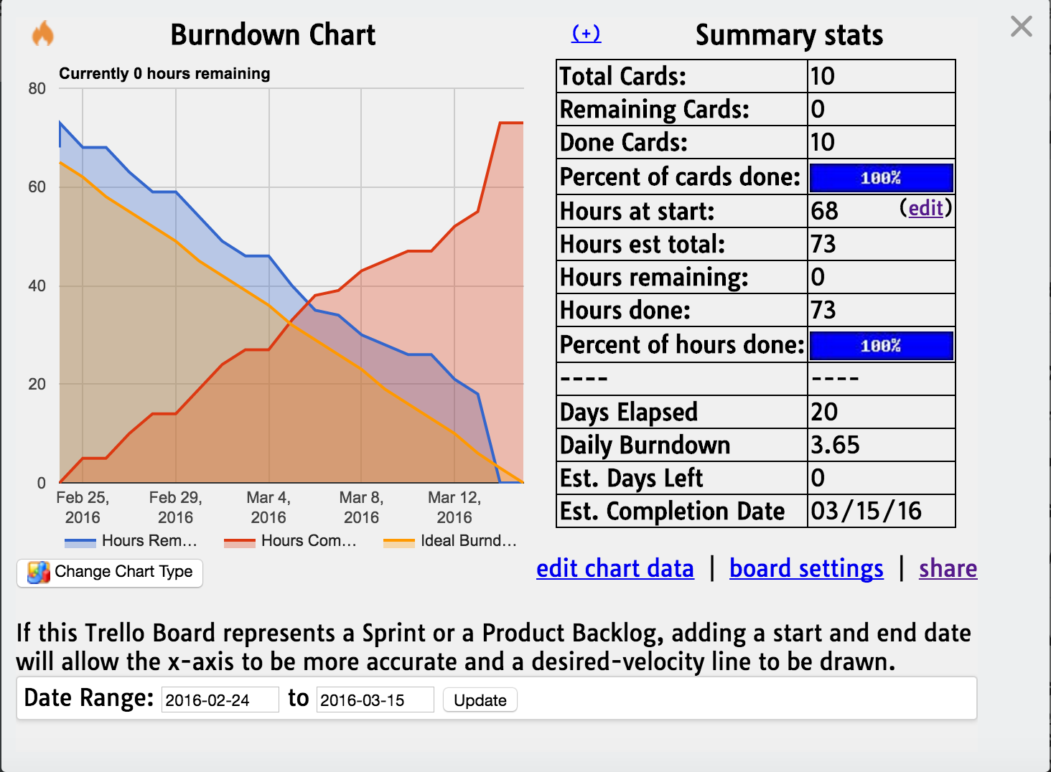
Trello Burndown:

Slide 6
Plan for Sprint 4: Mar 15
User story planned:
As a user , one must be able to run spark analytical job both on Spark Hadoop AWS and MOC Cluster with performance enhancements
Explore use cases for parallel processing of Spark Analytic jobs in MOC and AWS
Implement use cases for parallel processing of Spark Analytic jobs in MOC and AWS
Create benchmarking harness
Perform analysis of analytical jobs on both private and public cloud

Slide 7
DEMO: https://youtu.be/E97CWN_osIQ

Slide 8
Questions?

Slide 9
Thank You

